Slide 1
Organic Farming in Practice
Submitted by : Harsh Sharma
Class : BCA 2nd Year IV Semester
Batch : D1
Roll No : 22BCAN017
Submitted To : Dr. Blessy Thankachan

Slide 2
Contents
Introduction
The Importance of Soil Health
Crop Diversity and Resilience
Reducing Environmental Impact
Promoting Biodiversity
Challenges and Solutions
Community and Social Benefits
Conclusion

Slide 3

Introduction
In this presentation, we will explore the beneﬁts of organic farming and its impact on . We will delve
into the practices and principles that make organic farming a viable solution for the future of food production.

Slide 4

The Importance of Soil Health
Healthy soil is the foundation of
. Organic farming
focuses on enhancing soil fertility through natural processes, promoting biodiversity, and reducing reliance on synthetic inputs.

Slide 5
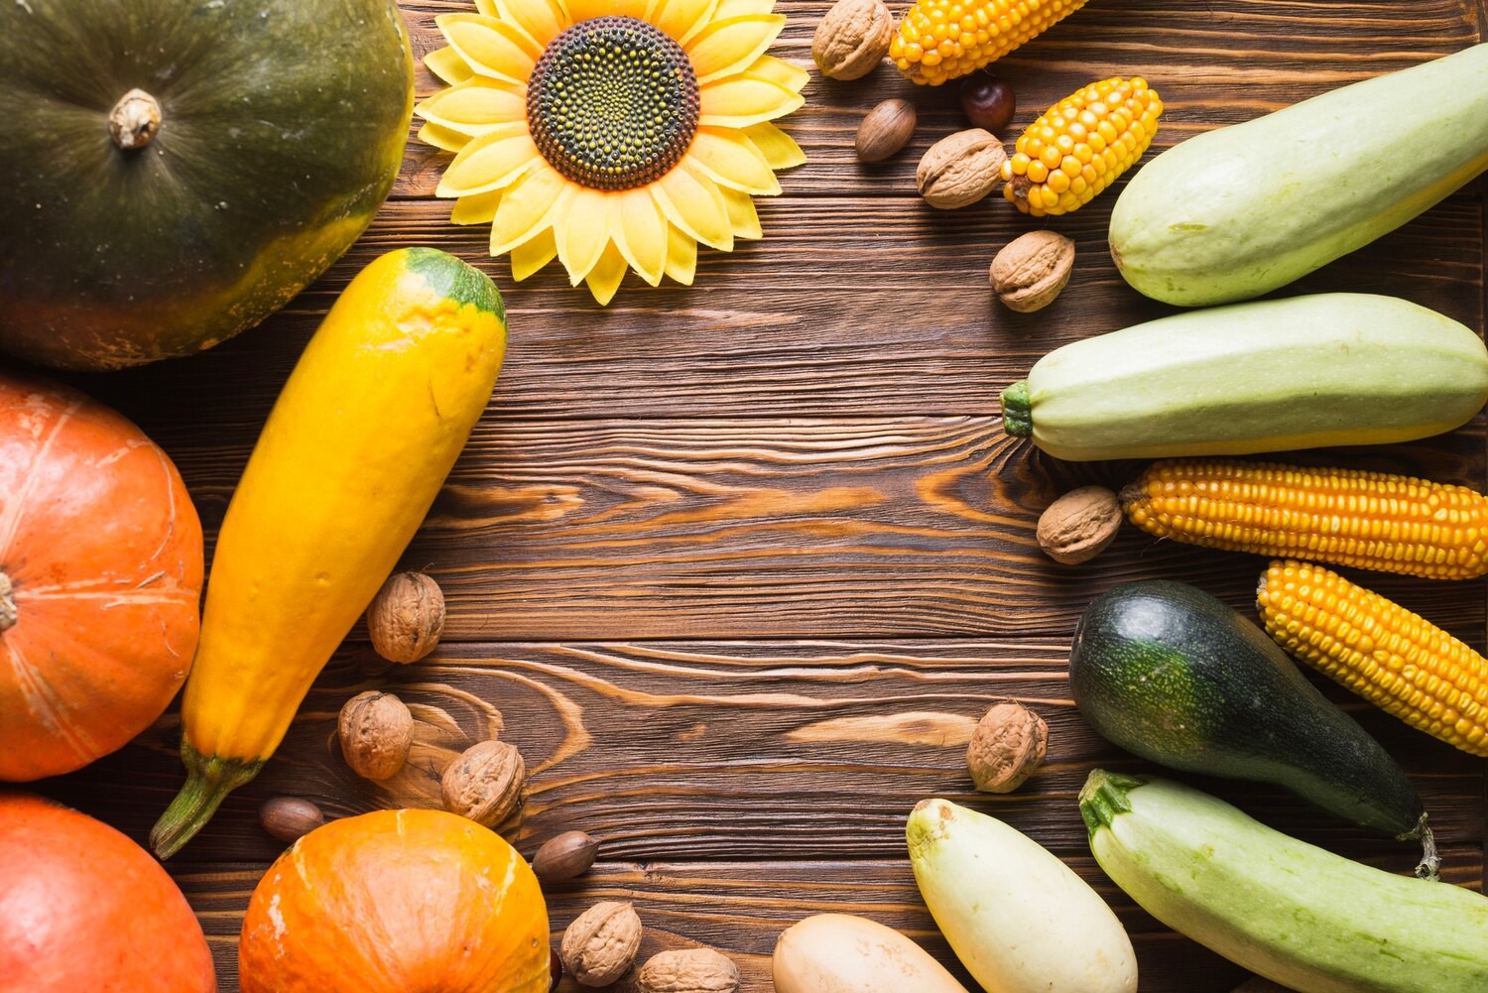


Crop Diversity and Resilience
Organic farms prioritize a wide variety of crops, which promotes
and reduces the risk of pest and disease outbreaks. This approach also
enhances the nutritional diversity of the food produced.

Slide 6

Reducing Environmental Impact
By avoiding synthetic pesticides and fertilizers, organic farming minimizes
and protects
ecosystems. The use of sustainable practices such as crop rotation and natural pest control further reduces environmental impact.

Slide 7

Promoting Biodiversity
Organic farms provide habitats for a wide range of , including
pollinators, natural predators, and soil microorganisms. This fosters a balanced
ecosystem and supports overall biodiversity.

Slide 8
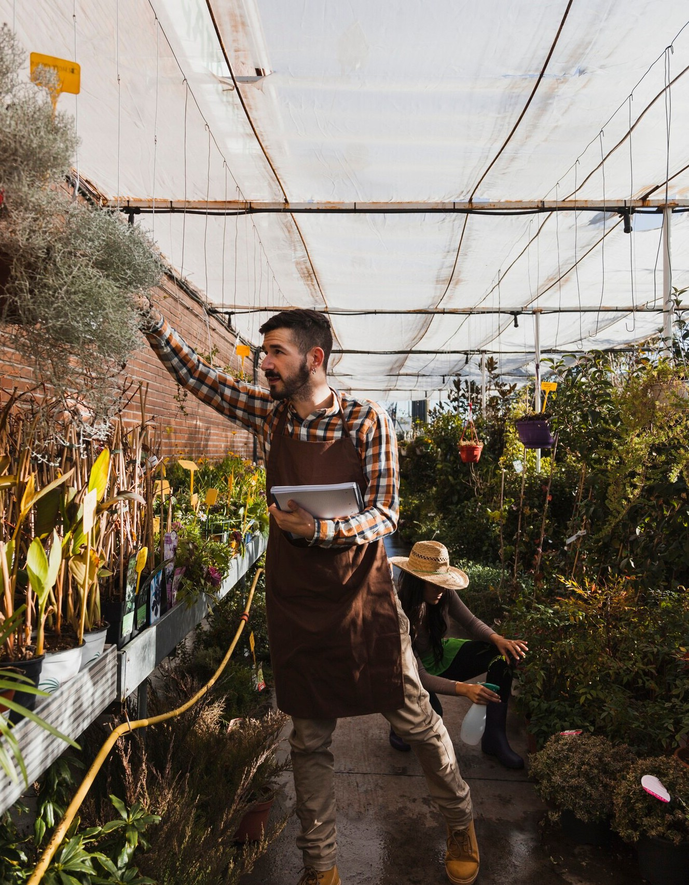
Challenges and Solutions
While organic farming presents challenges such as weed management and lower yields in the short term, innovative solutions such as agroecological practices and integrated pest management offer sustainable alternatives.

Slide 9


Organic farming can be economically viable through to consumers, reduced input costs, and premium prices for organic products. Supporting policies and ﬁnancial incentives can further enhance the economic sustainability of organic farms.

Slide 10



Community and Social Beneﬁts
Organic farming fosters
and promotes social well- being by connecting consumers with local, sustainable food sources. It also supports rural livelihoods and contributes to vibrant, resilient communities.

Slide 11
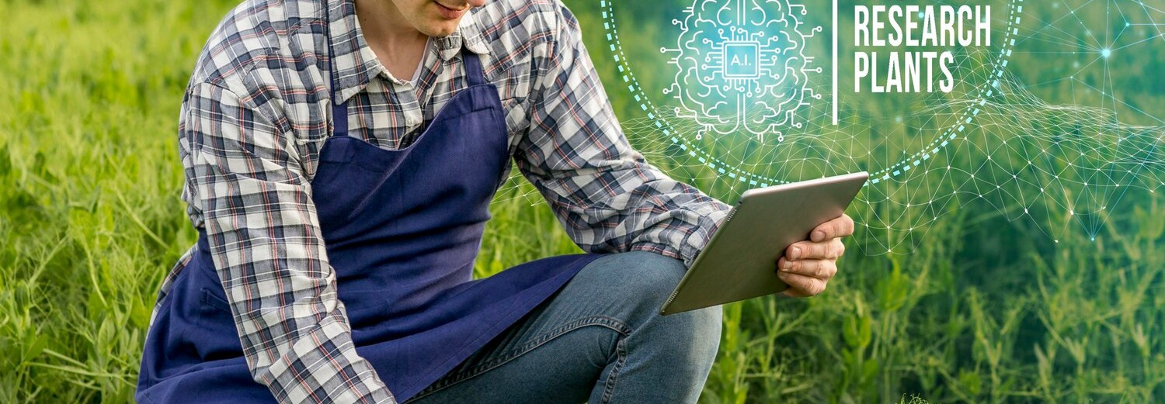
As the demand for continues to grow, the future of organic farming looks promising. Innovation, research, and collaboration will play crucial roles in advancing organic farming practices for a more sustainable future.

Slide 12
The global expansion of organic farming can have far-reaching
. Policymakers play a critical role in supporting organic farming through incentives, regulations, and research funding to promote its widespread adoption.

Slide 13

Consumer awareness and advocacy are essential in driving the growth of organic farming. Educating consumers about the beneﬁts of organic food and supporting initiatives that promote sustainable agriculture can create positive change.

Slide 14

Conclusion
Organic farming is a cornerstone of
, offering a holistic approach that prioritizes soil health, biodiversity, and environmental stewardship. By embracing organic farming practices, we can cultivate a more resilient and sustainable food system for future generations.

Slide 15
Thanks!

